Slide 1

Airbnb Berlin Performance
Visual Analytics Assessment
Vyshak Sugunan

Slide 2
Agenda
Project Objectives
Data and Analysis Methodology & Wireframes
Final Visualizations: Tableau Dashboard
Key Insights
Future Steps

Slide 3
Project Objectives
Assessing Overall Market Performance of Listings
Identify the factors separating high revenue listings from under performing ones
Identifying top revenue generating neighbourhood
Recommend strategies for improving poor performing properties
Evaluating performance of Host Listings
Identifying and tracking the characteristics of top performing hosts
Highlightling traits of superhosts’ success
Recommend strategies or best practices for all the hosts on Airbnb.

Slide 4
Data & Analysis

Slide 5
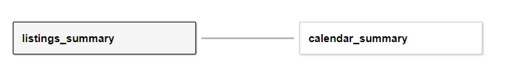
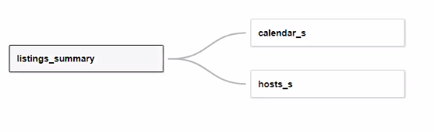
Data Description
Original Tables:
Listings_summary: 22,552 listings, 90+ columns
Calendar_summary: 8,231,480 (367 days)
Time Frame: November 2018 - November 2019
Main Parameters used:
Availability
Price
Score Rating
Neighborhood names & locations
Calculated Variables:
Occupancy – for each listing calculated as % of total days available
Revenue - derived from occupancy multiplied by listing price
Price / Sq ft, Revenue / Sq ft – for each neighborhood
Notes:
Added 2 tables -
Changed calendar table
Created host table
Variables - revenue per sq. ft, price per sq. feet, occupancy
Talk track -

Slide 6
Analysis Methodology
Data pre-processing and exploratory data analysis
Created new data tables for faster processing and ease of analysis
Finalizing Scope of Analysis -
Narrowed scope from initial 2 personas into 1
Identified dashboard targets - listing market performance, individual host performance
Creating Wireframe and Tableau Dashboard
Notes:
Added 2 tables -
Changed calendar table
Created host table
Variables - revenue per sq. ft, price per sq. feet, occupancy
Talk track -

Slide 7
Wireframes

Slide 8
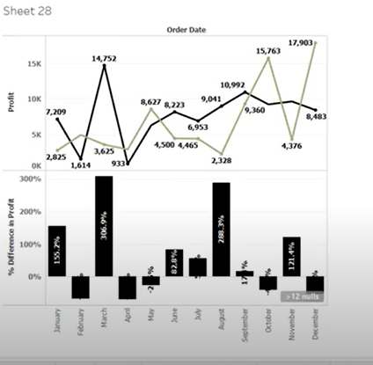
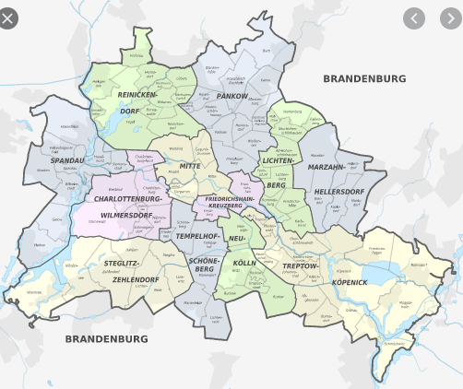
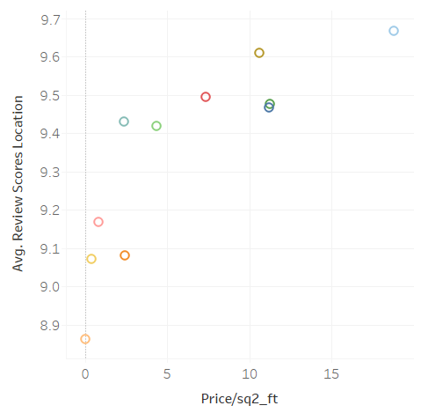
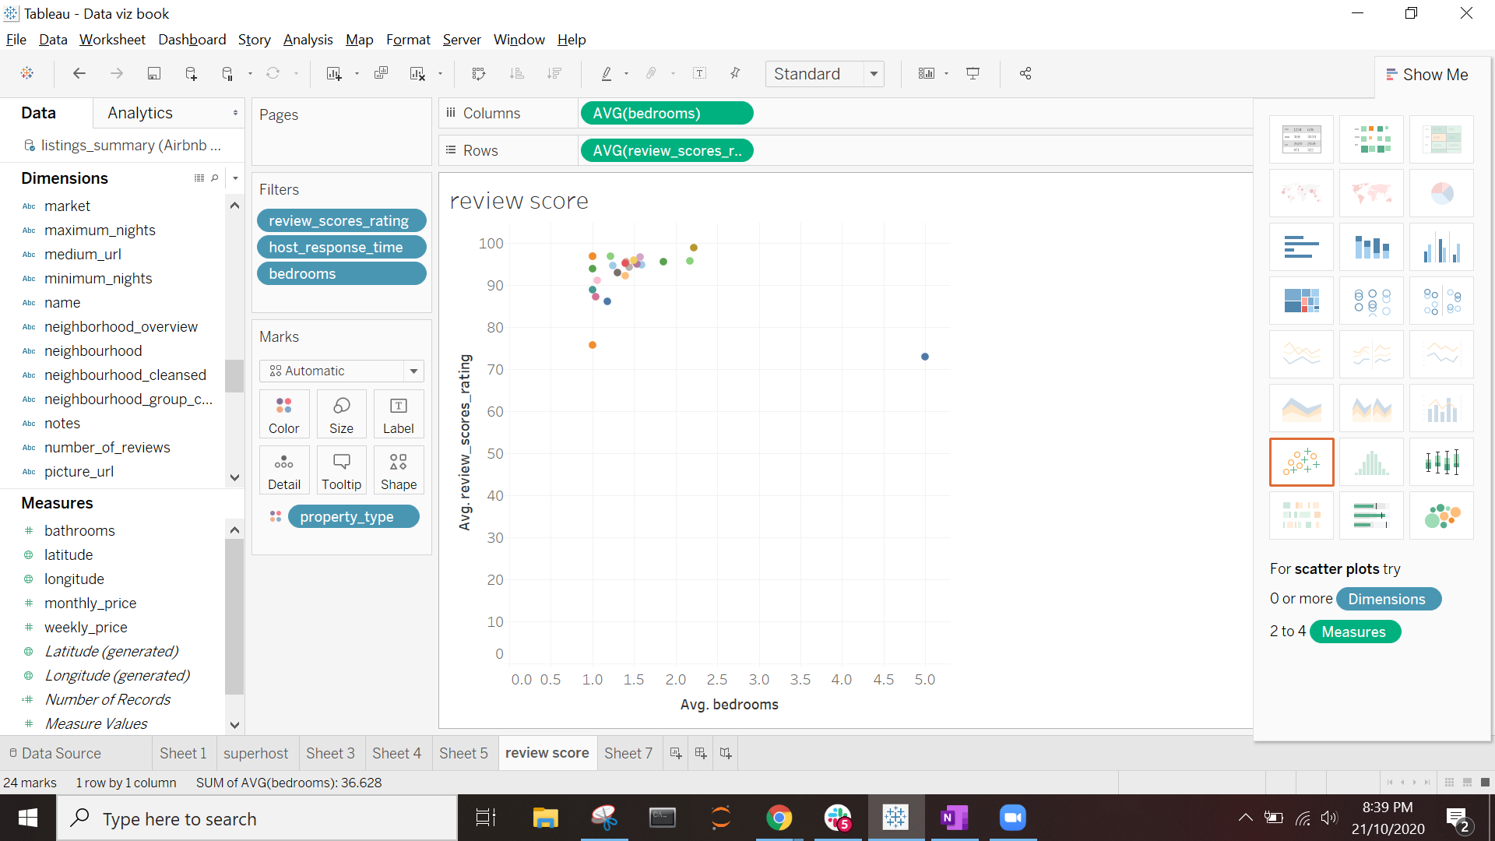
Performance Dashboard Wireframe
Objective: At the Neighborhood level - check characteristics that makes certain locations more appealing than others
Audience: Airbnb officials and potential Customers
Current Revenue Month | Average Revenue per Month | Occupancy
Revenue
Neighborhoods Grouped Cleansed
Revenue/sq. ft vs Price/sq.ft
Neighborhood (Size quantity of listings or available)
Neighborhoods Quality Performance

Slide 9
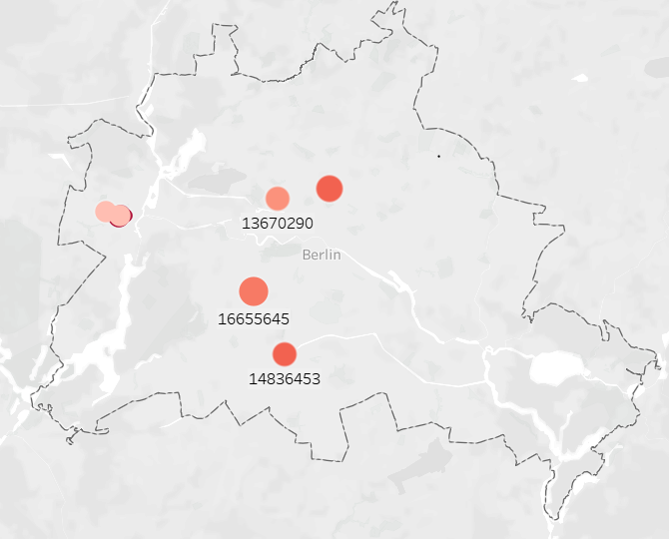
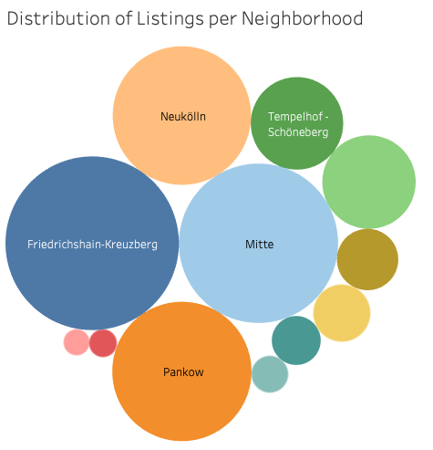
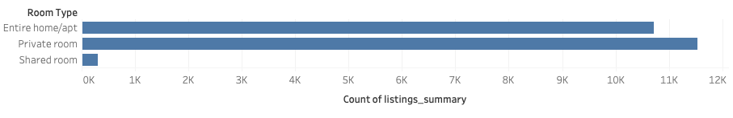
Objective: At the Host level - compare key metrics about listings to the average ones and identify which types are more popular.
Audience: Airbnb officials and Hosts
Host Dashboard Wireframe
How do you compare with other hosts?
 | Avg. Rating | Avg. Response Time | Avg. Price | Avg. Number of Amenities | Avg. Number of reviews
Host
All Hosts
Where are my listings?
Which listings are more popular?
Num Listing per NB
Room Type
Property Type

Slide 10
Final Visualizations: Tableau Dashboards

Slide 11
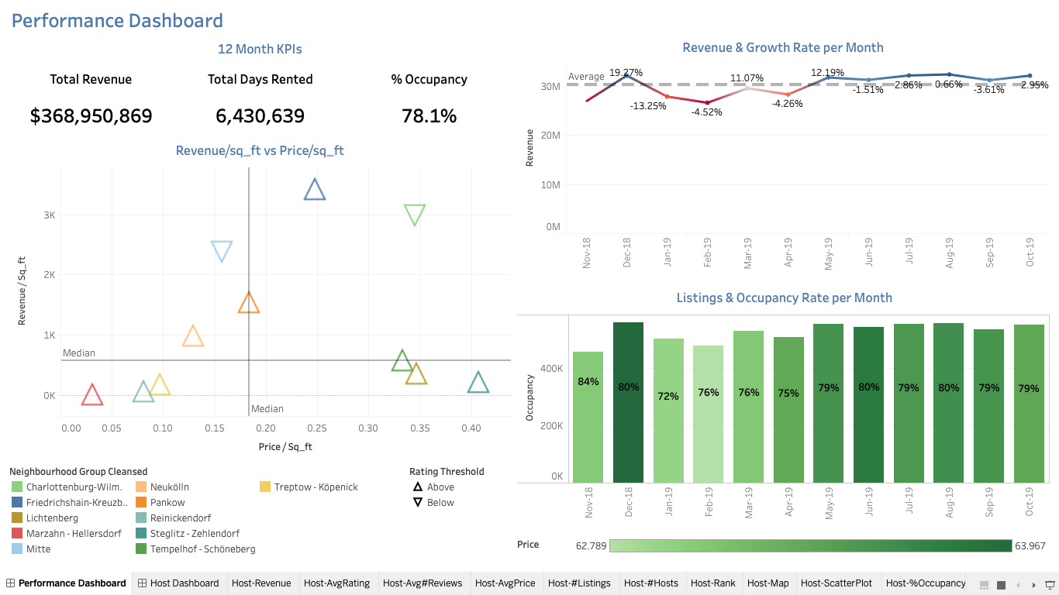

Slide 12
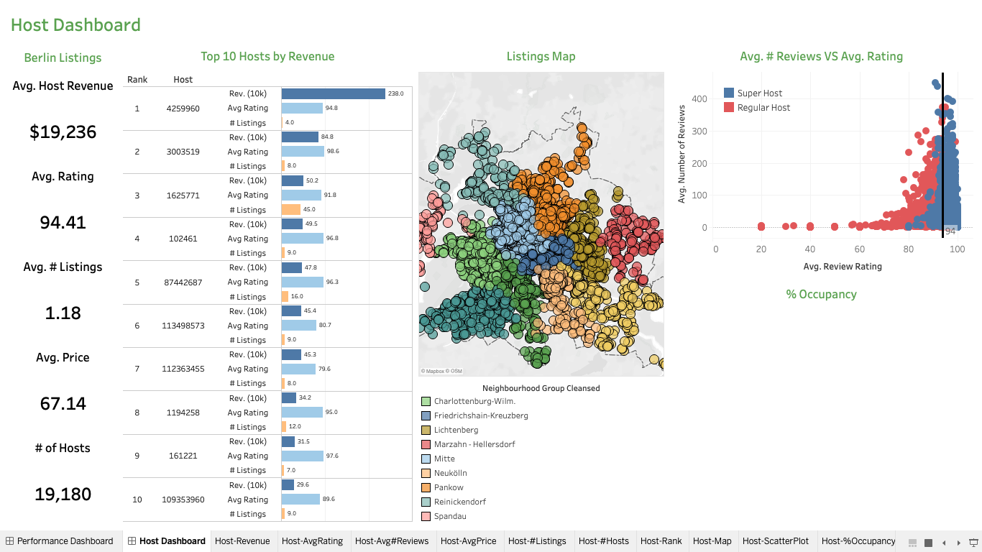

Slide 13
Key Insights and Recommendations

Slide 14
Key Insights
Listing and Neighborhood performance
Summers are more profitable than other months - December is an outlier
Location matters - Highest performing listings by revenue have high price per sq. feet but have poor quality score
Xmas bonus - Neighborhoods charge their highest price in the Christmas season(Nov-Dec)
Least popular neighborhood (based off occupancy %) seems to be the eastern neighborhood of Marzahn-Hellersdorf

Slide 15
Key Insights
Host performance
Superhost? - Only 4 out of the 10 top hosts by Revenue are superhosts
Primary business - Hosts with multiple listings bring in a huge share of revenue even though majority of hosts own a single listing
Undivided attention - Hosts having listings in the same neighborhood tend to have better reviews and higher chances of being a superhost
“Mitte” matters - Most hosts with higher revenue have listings in Mitte neighborhood

Slide 16
Future Steps
Additional Data Inputs from Client
More Historical Data
Data from different cities to compare
Knowledge of industry or company’s benchmarks
Understanding company’s long-term goals

Slide 17
Appendix

Slide 18
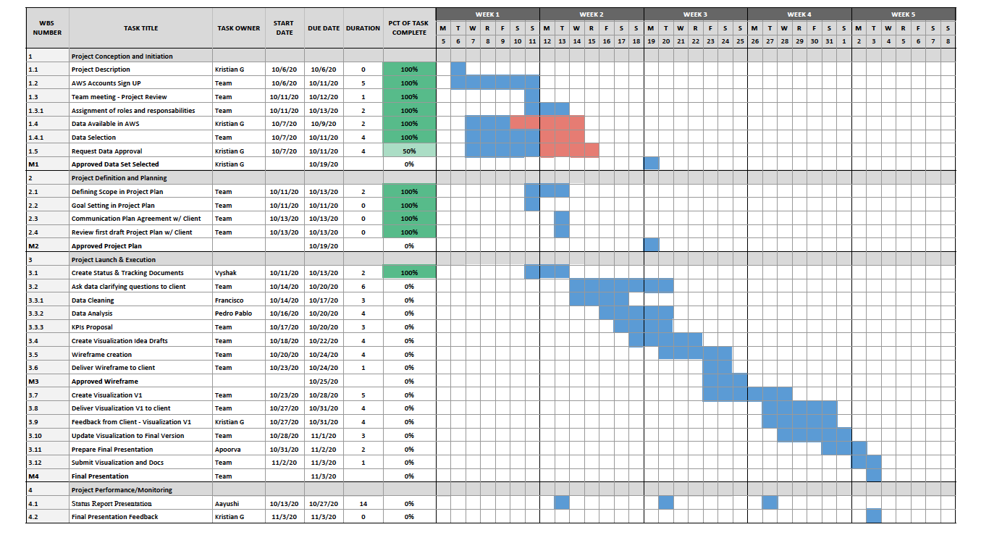
Project Plan

